Slide 1


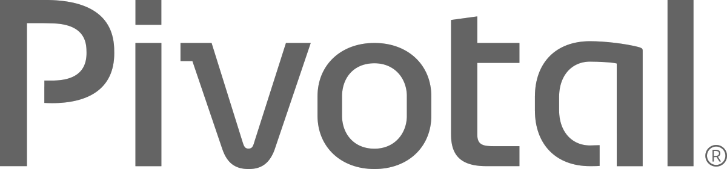
Cloud Native Enterprise
Spring 2016
Your Name / Title
you@pivotal.io
Notes:
Cloud Native is a term that recognizes that getting software to work in the cloud requires a broad set of components that work together. It also requires an architecture that departs from traditional enterprise application design, such as ‘Microservies’.
I want to talk to you about cloud native applications, and bringing microservice architectures into production in the enterprise.

Slide 2
Agenda
Why?
What?
How?

Slide 3
WHY?

Slide 4





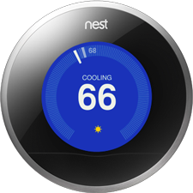
Software is Changing Industries

Slide 5

CLOUD NATIVE
Agile
Lean
Continuous
Delivery
Microservices
Cloud
DevOps

Slide 6
The Promise of Cloud Native
Deploy new features daily to production
Automate middleware
Free/Cheap horizontal scaling
Contract between App & Platform
Notes:
That is and should be a governing principle behind any cloud platform, library, or tool. Spring Cloud–an open-source library–makes it easy to develop JVM applications for the cloud. With it, applications can connect to services and discover information about the cloud environment easily in multiple clouds such as Cloud Foundry and Heroku. Further, you can extend it to other cloud platforms and new services.
Application Framework
Spring Cloud : used by Netflix
Spring Boot now over 1M downloads a month, historic levels of growth
Runtime platform
Cloud Foundry elastic runtime used by top FS leaders
Enterprise production ready Linux Container based platform
Infrastructure Automation
CF BOSH: Embedded OS, cloud API integrated
Incredible operational leverage; machine to machine automation

Slide 7
WHAT?

Slide 8
Characteristics of Cloud Native Architectures
Continuously Delivered
Twelve Factor Apps (http://12factor.net/)
Microservices
Self-Service agile infrastructure
API-based collaboration
Anti-fragility

Slide 9
Enabling Continuous Delivery
Development
Operations
Idea
Business
Customer
$
Value
QA
Companies that disrupt, reduce time to value

Slide 10
Enabling Agile Delivery
Behavior Analytics
Design
Development
Customer Feedback
Test
Customer Delivery

Slide 11
WaterScrumFall
Production Release
#1
Waterfall Organization
Production Release
#2
Agile Development

Slide 12
Conway’s Law
“Any organization that designs a system (defined broadly) will produce a design whose structure is a copy of the organization's communication structure.”
- Melvin Conway, 1967
http://www.melconway.com/Home/Committees_Paper.html
Notes:
Inverse Conway Maneuver coined by Thoughtworks - http://jonnyleroy.com/2011/02/03/dealing-with-creaky-legacy-platforms/
Goal is to create self contained, business aligned teams with the smallest feedback loop.
Business capability teams interact with platform operations team via APIs and not meetings. This creates a friction free experience for the business capability team who now have the tools to

Slide 13
Inverse Conway Maneuver Enable Continuous Delivery
Product Mgr.
Dev
UX
QA
DBA
Self
Service
APIS
Sys Admin
Network Admin
Storage Admin
Business Capabilities Team Using Microservices
Platform Operations Team
http://jonnyleroy.com/2011/02/03/dealing-with-creaky-legacy-platforms/
http://www.slideshare.net/adriancockcroft/microservices-the-good-bad-and-the-ugly
Notes:
References:
Inverse Conway Maneuver coined by Thoughtworks - http://jonnyleroy.com/2011/02/03/dealing-with-creaky-legacy-platforms/
http://www.slideshare.net/adriancockcroft/microservices-the-good-bad-and-the-ugly
Notes:
Goal is to create self contained, business aligned teams with the smallest feedback loop.
Business capability teams interact with platform operations team via APIs and not meetings. This creates a friction free experience for the business capability team who now have the tools to

Slide 14
Enabling Continuous Delivery
Production Release
ORDERS
Production Release
Production Release
SHIPPING
Production Release

Slide 15
12-Factor Applications
Codebase
Dependencies
Configuration
Backing Services
Build, release, run
Processes
Port binding
Concurrency
Disposability
Dev/prod parity
Logs
Admin processes
APPS
contract
Cloud Platform
Architectural and development practices – http://12factor.net
Notes:
References:
http://12factor.net/
Architectural and development practices, that ensure an optimal experience on a cloud platform.

Slide 16
Microservice: Definition
If every service has to be updated in concert, it’s not loosely coupled!
“ Loosely coupled service oriented architecture with bounded contexts"
If you have to know about surrounding services you don’t have a bounded context.
- Adrian Cockcroft

Slide 17
Microservices are NOT
Monolithic Application
Service
Service
HTML
JavaScript
MVC
Enterprise Service Bus
Service
Service
OR
Data Access
Service
Service
Tightly Coupled
Centralized

Slide 18







Microservice Architecture
Relational
DB
HTTP
HTTP
Key/Value
Store
HTTP
HTTP
HTTP
…
AMQP
AMQP
HTTP
Graph
DB
Notes:
REST and message-driven services
Polyglot persistence, services encapsulate data store semantics
Diversity of clients acknowledged
API Gateway for service aggregation, reduce chattiness, protocol translation, reduce latency/round-trips, deal with mobile device fragmentation, build use case/device specific API’s

Slide 19
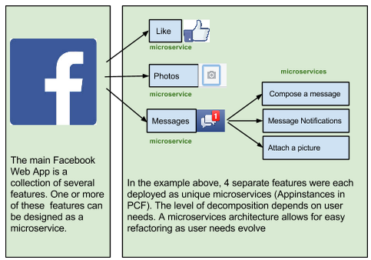
A Familiar Microservice Example

Slide 20
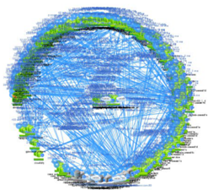
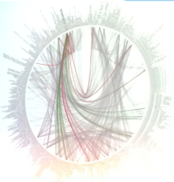
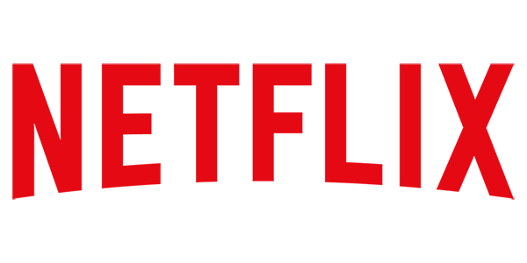
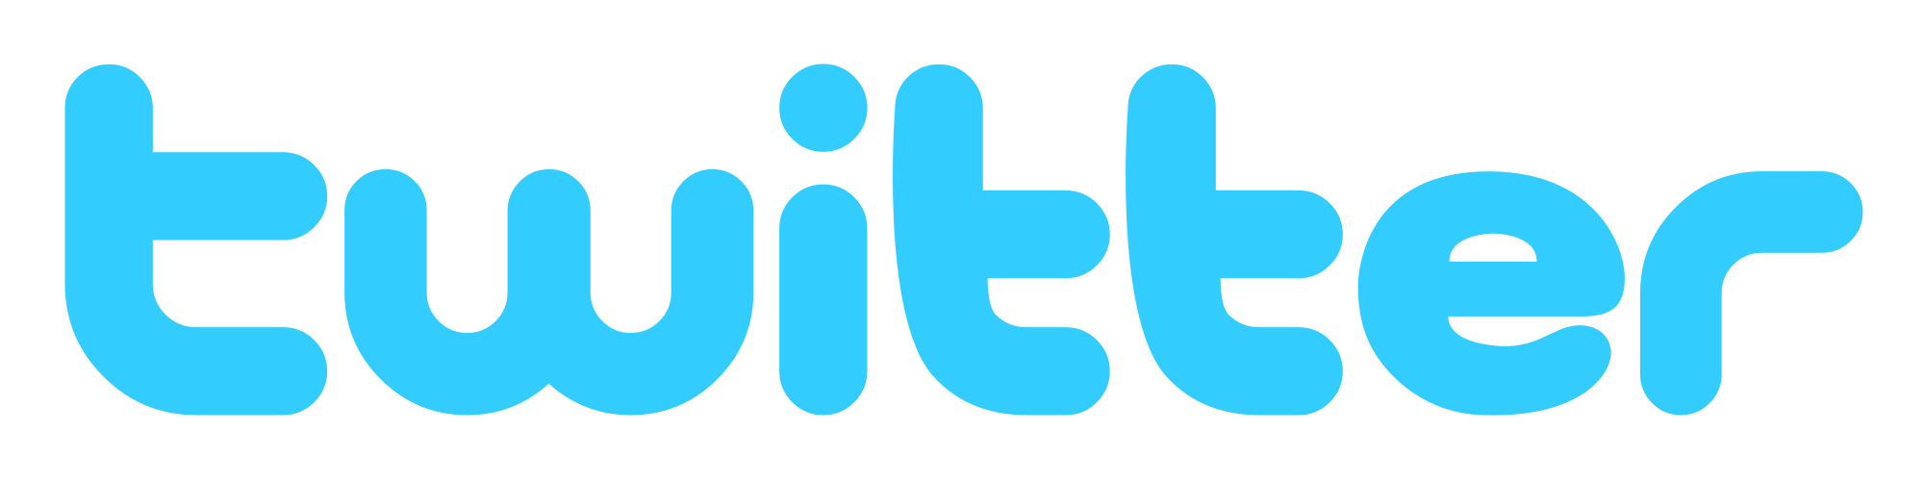
Microservices are Hard

Slide 21
Challenges of Distributed Systems
Configuration Management
Service Registration & Discovery
Routing & Load Balancing
Fault Tolerance (Circuit Breakers)
Monitoring
Concurrent API Aggregation & Transformation
Notes:
Everybody faces these, SCS takes PCF to the next level

Slide 22
HOW?

Slide 23
It Takes a Platform
An end-to-end platform that makes implementing distributed application best practices, a turn-key and first practice
Notes:
Inverse Conway Maneuver coined by Thoughtworks - http://jonnyleroy.com/2011/02/03/dealing-with-creaky-legacy-platforms/
Goal is to create self contained, business aligned teams with the smallest feedback loop.
Business capability teams interact with platform operations team via APIs and not meetings. This creates a friction free experience for the business capability team who now have the tools to

Slide 24

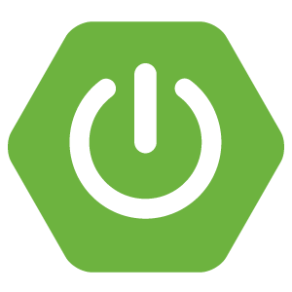
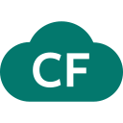
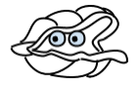
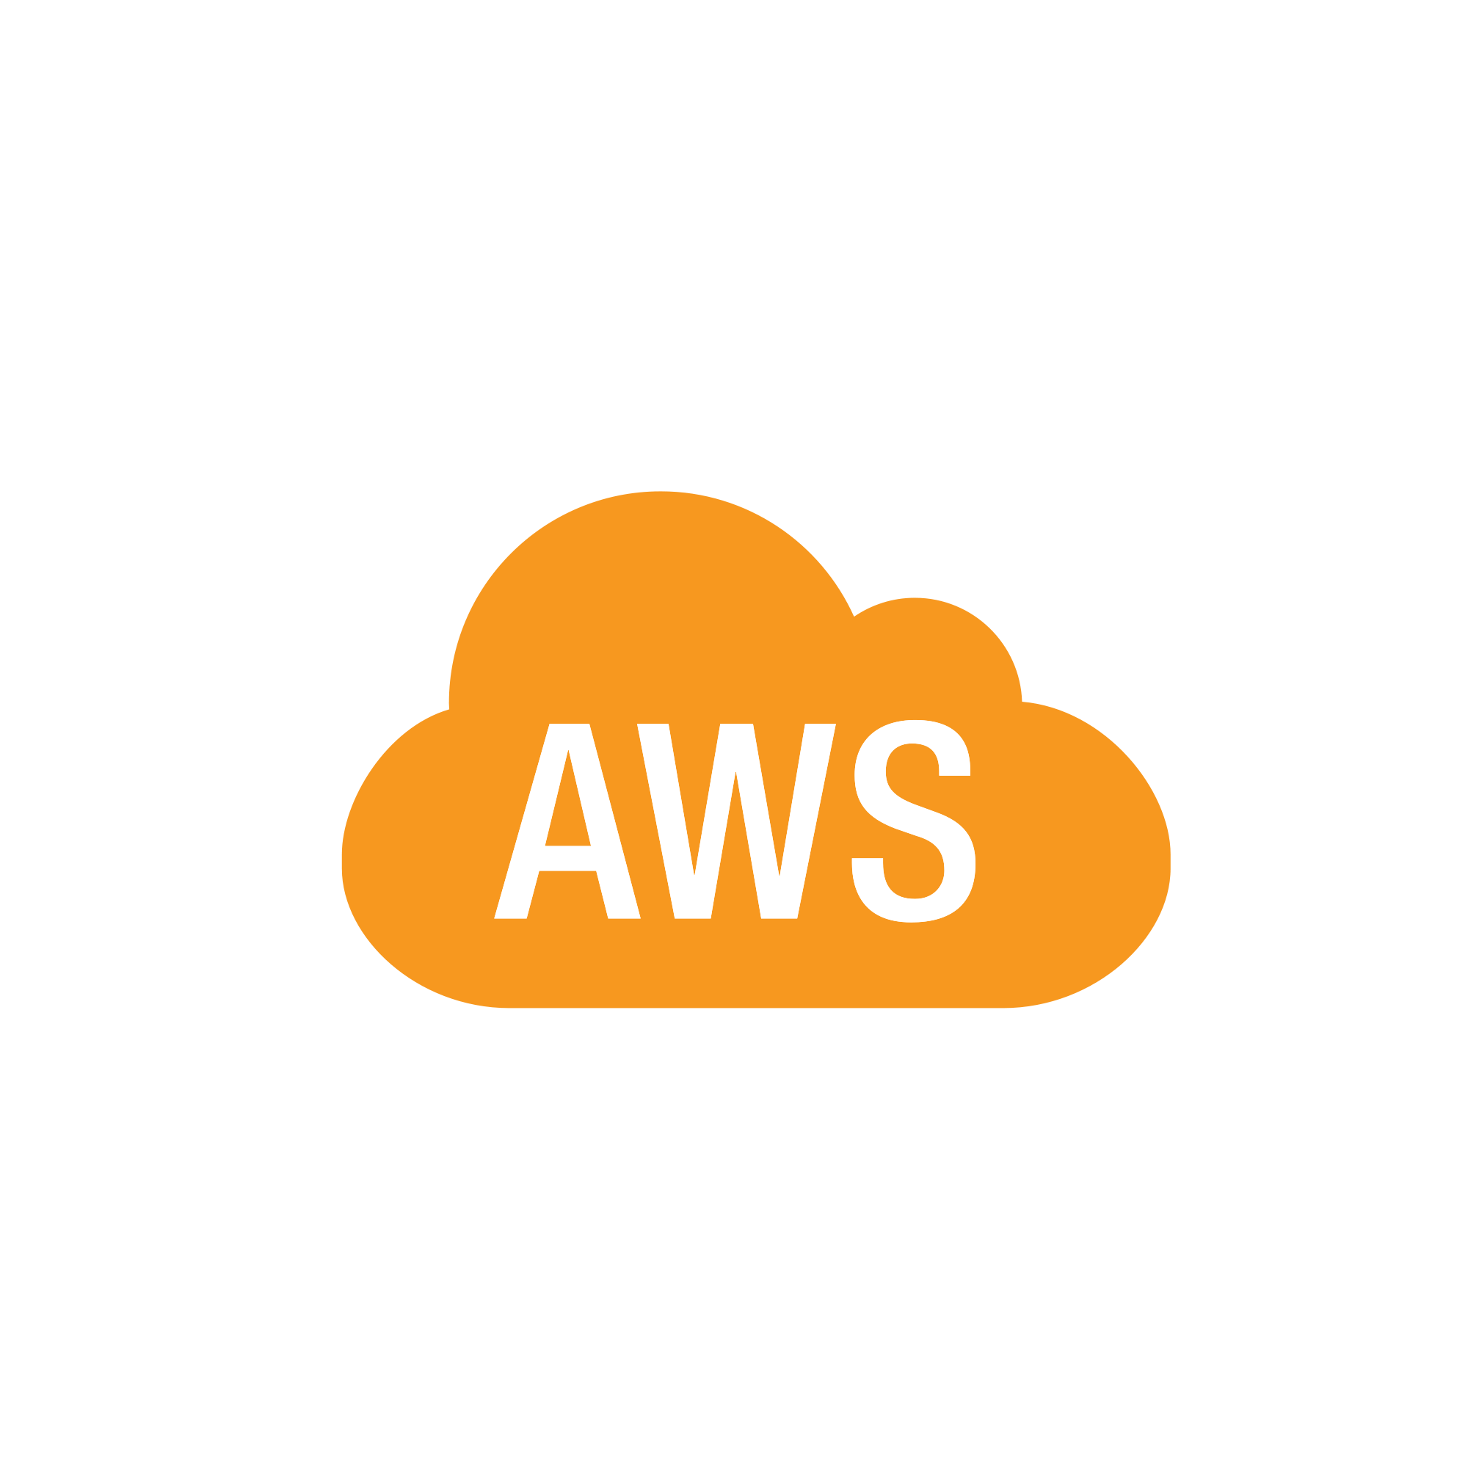

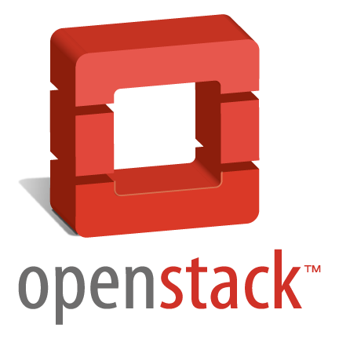
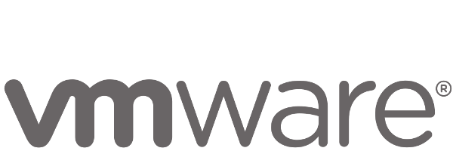
Anatomy of a Cloud Native Platform
1. Application Framework
Developer
Contract – 12 Factor App
2. Container Runtime
Dev+Ops
Contract – BOSH Release
IT Ops
3. Infrastructure Automation
Contract – Cloud Provider Interface
4. Infrastructure
IT Ops
Azure
“Contracts” between Applications, opinionated frameworks like Spring Boot and Spring Cloud and opinionated Cloud Native Platforms like Cloud Foundry help significantly accelerate the development of Cloud Native applications
Notes:
That is and should be a governing principle behind any cloud platform, library, or tool. Spring Cloud–an open-source library–makes it easy to develop JVM applications for the cloud. With it, applications can connect to services and discover information about the cloud environment easily in multiple clouds such as Cloud Foundry and Heroku. Further, you can extend it to other cloud platforms and new services.
Application Framework
Spring Cloud : used by Netflix
Spring Boot now over 1M downloads a month, historic levels of growth
Runtime platform
Cloud Foundry elastic runtime used by top FS leaders
Enterprise production ready Linux Container based platform
Infrastructure Automation
CF BOSH: Embedded OS, cloud API integrated
Incredible operational leverage; machine to machine automation

Slide 25
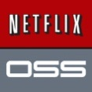
Application Framework
Spring
Spring Boot
Distributed Config
Service Registration and Discovery
Routing/Load Balancing
Service Integration
Fault Tolerance
Spring Cloud
#1 Enterprise Java App Framework
Netflix
Open Source
Quick Start
Little to no Config
Opinionated View
Pivotal is the main custodian of Spring and we hire the main committers for Spring Boot and Spring Cloud. We can bring these resources to bear to help significantly accelerate a customer’s journey to becoming a Cloud Native enterprise
Notes:
#1 Enterprise Java App Dev Framework
Used heavily by Netflix and F2000
OSS, Apache 2.0 licensed
Millions of downloads
Integrated into PCF, BDS

Slide 26



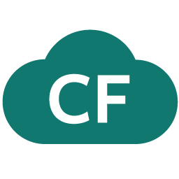
Spring Cloud
Notes:
http://www.wired.com/wp-content/uploads/2014/06/google-cloud.jpg
This is stuff we have tiles for
Ribbon and Hystrix are really client libraries – hence no tile.
This is what’s in the box for 1.0 –
Service Registry: Eureka (not any others, need something that “just works” for devs
Config Server – can use SVN, Git
Circuit Breaker – Hystrix Dashboard + turbine.

Slide 27
Companies want to be fast like Netflix
Netflix needed to be faster to win / disrupt
Pioneer & vocal proponent of microservices - the key to their speed and success
Netflix OSS supplies parts, but it’s not a solution
Difficult for enterprises to build it themselves
Pivotal offers the closest thing to “Netflix in a box” today
“
“Velocity on the JVM is the Killer App”
- Andy Glover (Netflix Eng) @ SpringOne2GX 2014 Keynote
https://youtu.be/xU267-YHN5c?t=1938
Notes:
NetFlix, an undisputed business & technology leader
34% of peak N. American internet traffic from 6-9pm
If speed was why they won, microservices was how
They pioneered / began to popularize micro service concept
All they had was Amazon EC2 back then
They had to invent a distributed platform, cloud native platform with PaaS – like features
They had to invent microservice infrastructure at the application level
All before writing one line of code that relates to the application you and I know as Netflix
NetflixOSS is a talent acquisition and retention strategy, they are in the movie business 1st, and the software business 2nd.
Open source and supporting their developer’s efforts in the industry is how they are able to attract and retain the best engineers, giving them the ability to invent all this stuff.
That’s tough to duplicate.
Detail on Netflix quote: Netflix needed the performance, stability, concurrency of the JVM, but was searching the right RAD capability to give them the velocity they wanted.

Slide 28
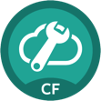
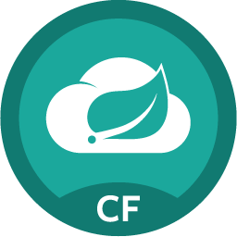


Spring Cloud Services Suite
Github URL for Config Repo provided via Service Dashboard (post-provisioning)
Config Server
Service Registration and Discovery via Netflix OSS Eureka
Service Registry
Spring Cloud
Services
Spring Cloud
Services
Netflix OSS Turbine + Hystrix Dashboard
Aggregation via AMQP (RabbitMQ)
Circuit Breaker Dashboard
Notes:
Config Server
Git URL for Config Repo provided via Service Dashboard (post-provisioning)
Single tenant, scoped to CF space (nothing prevents shared Git repo)
Service Binding via Spring Cloud Connector
Service Registry
Service Binding via Spring Cloud Connector

Slide 29




It Takes a Platform
Platform Runtime
Services
Routing
Container Scheduling
Service Discovery
Configuration
Database
Application Framework
Big Data
12 Factor Apps
Microservices
RESTful Services
Circuit Breakers
Object Storage
Mobile
Spring Boot
Ruby on Rails
Node.js
.NET
Build CI
User Provided
Logging & Metrics
Messaging
Operations
Zero Downtime Deployments
Failover & Recovery
Scaling
Security Patching
Platform
Upgrades
Azure

Slide 30


D e m o
Notes:
Spring Cloud
Push UI
While app is uploading talk through creating and binding of services
App appears in Service Registry
Show App… no server on backend
Show Hystrix Dashboard — circuit open
siege -c 10 -v http://fortunes-ui.vert.fe.gopivotal.com/random
Push Backend fortune app
While app deploys show some code that enables this
Annotations
ribbon reference in rest template
Hysterix
App is in Eureka — Show app connecting successfully
UI app has actuator enabled… hystrix metrics come in here

Slide 31
HOW?
Do we get started

Slide 32
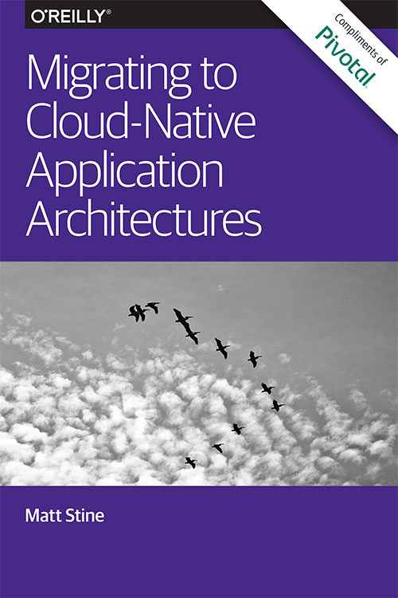
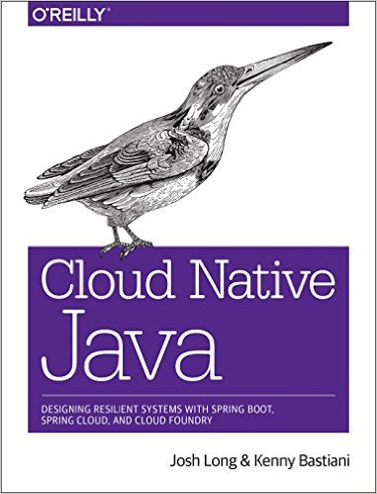
Read
By Matt Stine (@mstine)
By Josh Long (@starbuxman)
and Kenny Bastani

Slide 33
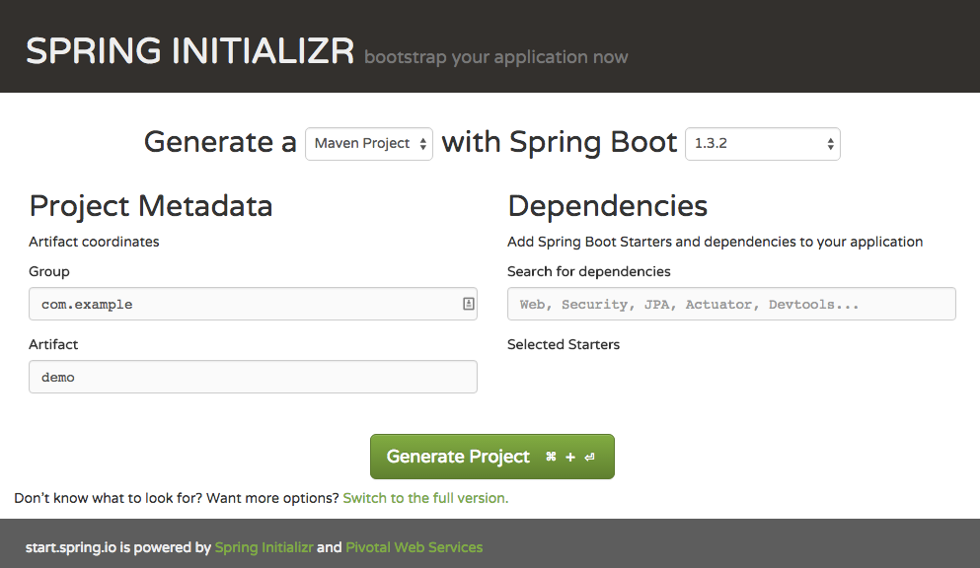
Bootstrap your Application Now: http://start.spring.io

Slide 34
Get PCF on a Single Machine with MicroPCF https://github.com/pivotal-cf/micropcf
Developer Experience Same as PCF
Custom Buildpacks
Docker Support
Service Brokers
Provides Logging
Application HA
Application Scaling
VM Process Monitoring (BOSH/Monit)
Uses Diego Runtime
Single VM (T2.Small on AWS OK!)
Apps restart after Stop/Start VM
Roadmapped:
Apps Manager GUI
Runtime version Parity with PCF
Not supported/provided:
Ops Manager
BOSH & 4 Level H.A.
Notes:
Same developer experience
Both Support Custom Buildpacks and service borkers
Both include BOSH (albiet differently)
Both use Diego Runtime
Both support Docker
Both have application HA and scaling
Both allow service brokers
Single VM vs. 26 VMs (t2.small OK!)
No Apps/Opps Manager (Roadmapped)
No tiles in Micropcf
Monit Process Monitoring vs 4 Levels H.A.
Runtime Version Parity with PCF is planned

Slide 35
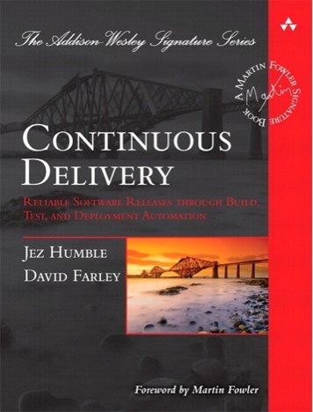
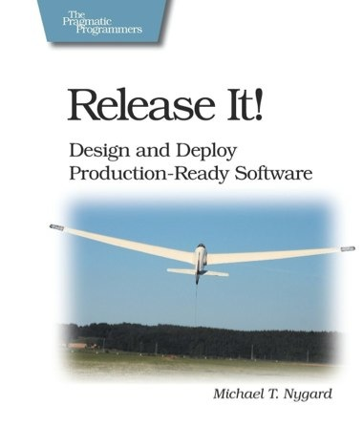
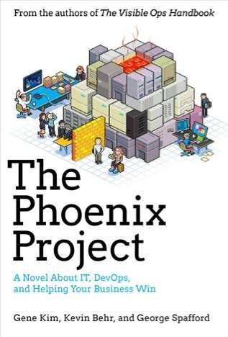
Foundations
Notes:
continuous integration of development changes
one package / many deploys
automation
deploy smaller batches more frequently
automate all testing where test failures would prevent prod release

Slide 36
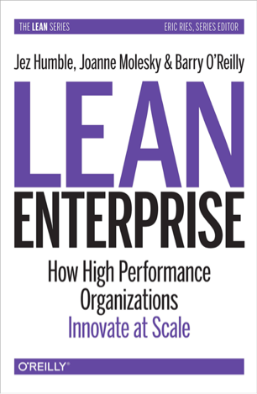
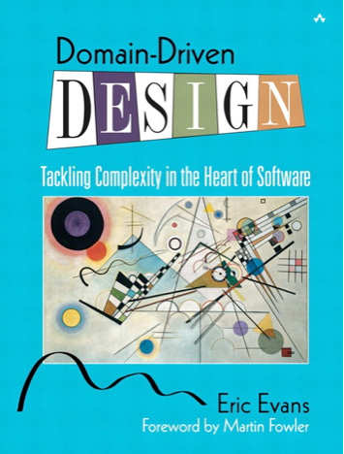
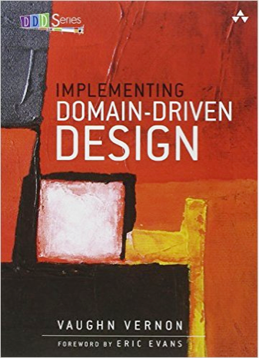
Foundations
Notes:
continuous integration of development changes
one package / many deploys
automation
deploy smaller batches more frequently
automate all testing where test failures would prevent prod release

Slide 38
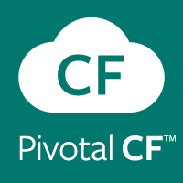


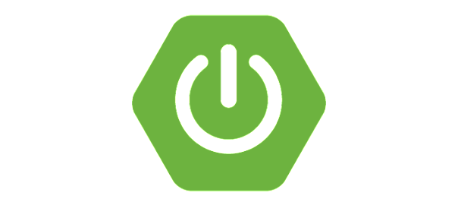

Anatomy of a Cloud Native Platform
Deployment and operations boilerplate patterns
(provisioning, deploy, security, logging, data services, etc.)
PaaS
Pivotal Cloud Foundry
Application coordination boilerplate patterns
Spring Cloud
Application Configuration boilerplate patterns
Desktop
Spring Boot
Application boilerplate patterns
Spring IO

Slide 39
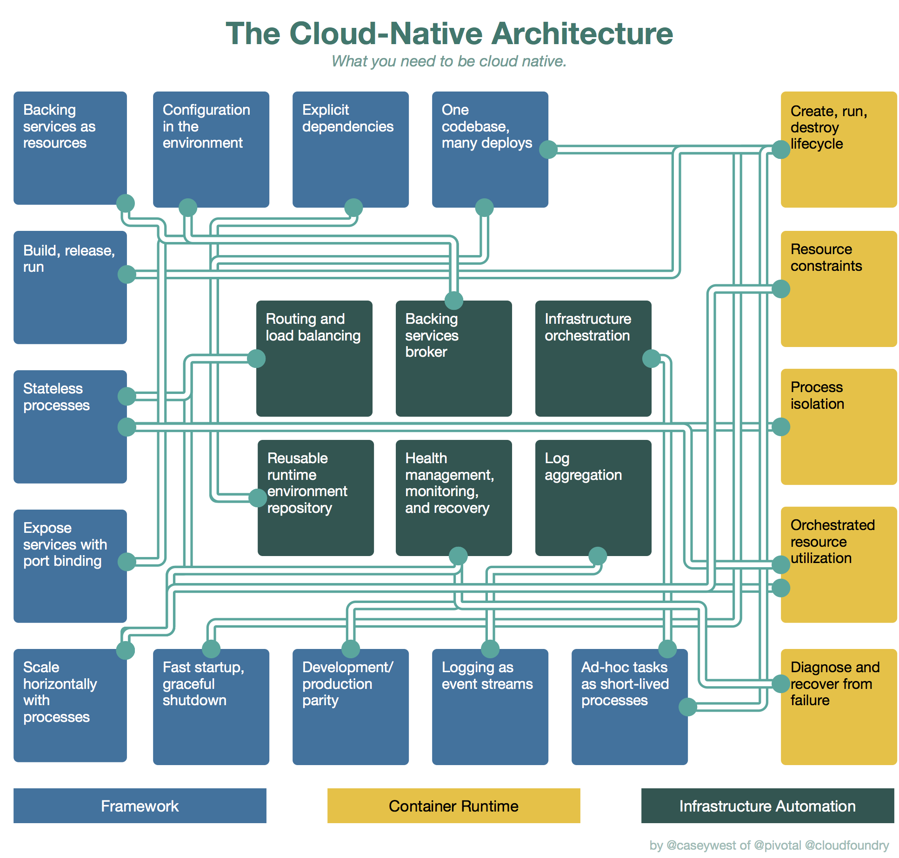
A cloud platform enables continuous delivery speed by standardizing and automating as much as possible

